Slide 1
What is Blazor? And why’s it so exciting?

Slide 2


Hi, I’m Chris… 👋
🏆 Microsoft MVP
💻 Blogger: chrissainty.com
📗 Author: Blazor in Action (35% off au35sai)
🔧 Open Source..r?: Blazored

Slide 3
What is Blazor?

Slide 4

Blazor is a framework for building
interactive web-based UIs

Slide 5
Brainchild of Steve Sanderson
Uses Razor (C#, HTML and CSS)
Applications are built using components
Uses a virtual DOM called a Render Tree
Works in all modern browsers, including mobile

Slide 6
Code Sharing
Component Libraries
Hot Reload
.NET Ecosystem
AOT
Debugging
Prerendering
JavaScript Interop
Dependency Injection
Assembly Shaking

Slide 7
How does Blazor work?

Slide 8
Blazor separates how changes are calculated from how they’re applied

Slide 9
App/Component Model
Hosting Model (Renderers)

Slide 10

Blazor
Web Renderer
Component Model

Slide 11
Blazor
Client
Web Renderer
Component Model

Slide 12

Blazor
Native Renderer
Web Renderer
Component Model

Slide 13
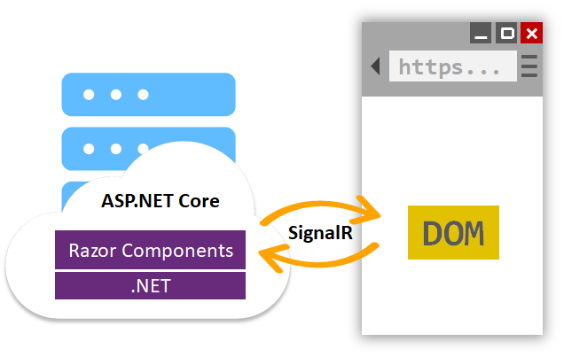
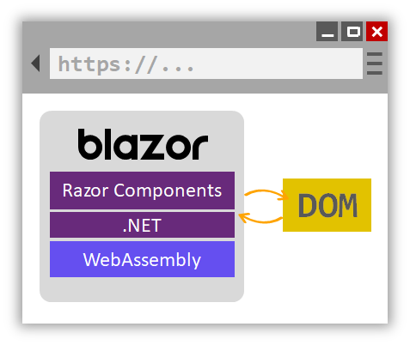
Web Hosting Models
Server
WebAssembly

Slide 14
Web Hosting Models
Server
WebAssembly

Slide 15
Web Hosting Models
Server
WebAssembly

Slide 16
<div>
<p>Current count: @currentCount</p>
<button class="btn btn-primary" @onclick="IncrementCount">Click me</button>
</div>
@code {
private int currentCount = 0;
private void IncrementCount()
{
currentCount++;
}
}

Slide 17
public partial class Counter : ComponentBase
{
protected override void BuildRenderTree(RenderTreeBuilder __builder)
{
__builder.OpenElement(0, "div");
__builder.OpenElement(1, "p");
__builder.AddContent(2, "Current count: ");
__builder.AddContent(3, currentCount);
__builder.CloseElement();
__builder.AddMarkupContent(4, "\r\n");
__builder.OpenElement(5, "button");
__builder.AddAttribute(6, "class", "btn btn-primary");
__builder.AddAttribute(7, "onclick", EventCallback.Factory.Create<MouseEventArgs>(this, IncrementCount));
__builder.AddContent(8, "Click me");
__builder.CloseElement(); __builder.CloseElement();
}
private int currentCount = 0;
private void IncrementCount()
{
currentCount++;
} }

Slide 18
Blazor WebAssembly

Slide 19
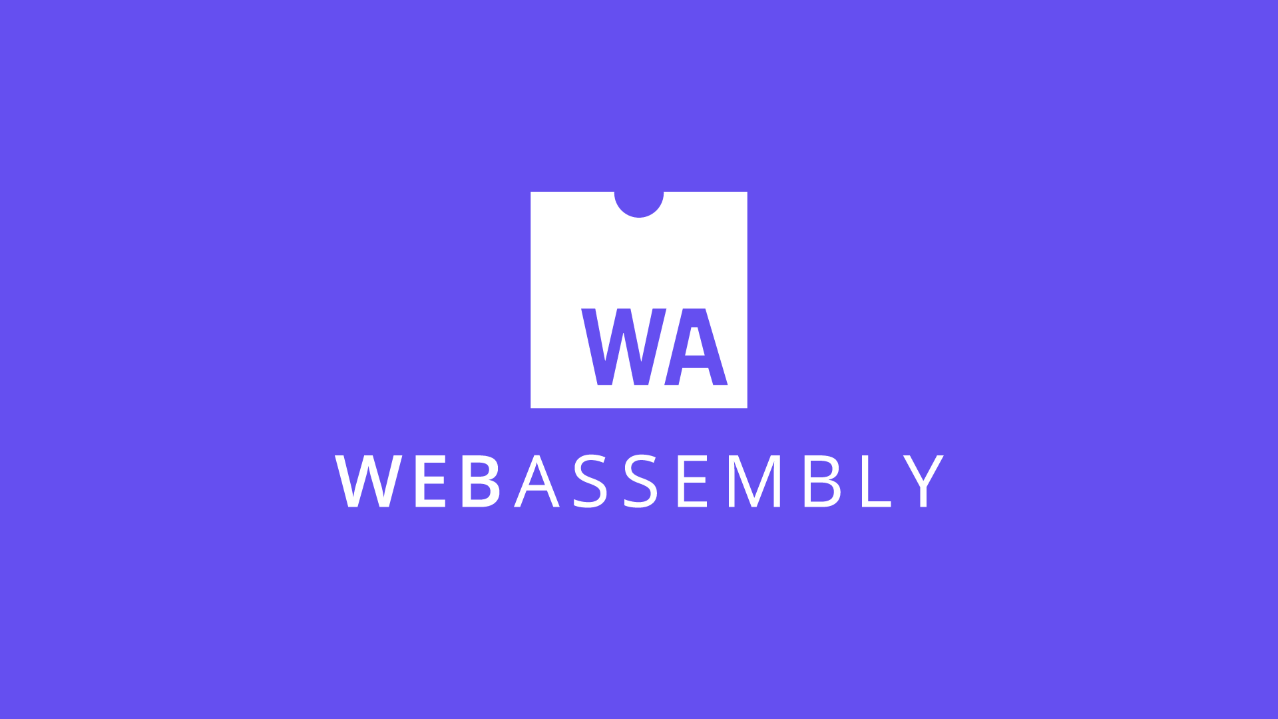

Slide 20

What is WebAssembly (Wasm)?
WebAssembly is a binary code format and it’s fast!
Compilation target for higher level languages
It’s a web standard, the 4th language for the web
Supported in all major browsers, including mobile
Notes:
WASM – Virtual Machine
WASI – Virtual Operating System

Slide 21
C++
WASM
get_local 0
i64.const 0
i64.eq
if i64
i64.const 1
else
get_local 0
get_local 0
i64.const 1
i64.sub
call 0
i64.mul
end
int factorial(int n) {
if (n == 0)
return 1;
else
return n * factorial(n-1);
}

Slide 22
What is WebAssembly (Wasm)?
WebAssembly is a binary code format and it’s fast!
Compilation target for higher level languages
It’s a web standard, the 4th language for the web
Supported in all major browsers, including mobile
Notes:
On December 5 2019, The World Wide Web Consortium (W3C) announced that the WebAssembly Core Specification is now an official web standard.
This makes WebAssembly the fourth language for the web, following HTML, CSS, and JavaScript.

Slide 23
Your application is NOT compiled to WebAssembly by default
Mono.net Runtime
Emscripten Toolchain
dotnet.wasm

Slide 24



_
X
https://wasm.blazor.net/
App
Blazor
dotnet.wasm
Static HTML
CSS
Images
JavaScript
dotnet.wasm
Application DLLs
Web Server
blazor.webassembly.js
DOM

Slide 25



_
X
https://wasm.blazor.net/
Search Results
App
Search Component
Blazor
Load more…
Blazor
DOM
Web API
Load more…

Slide 27
Runs on the client
Off loads work to the client - Great for scalability
Can Work offline
Trivial to make a Blazor WebAssembly app a PWA
Deployed as static files
Access to cheap/free hosting
Code Sharing
Use the same code on the front-end and back-end

Slide 28
Performance
Can be slower for CPU intensive tasks
Payload Size
1.0 mb (depending on the app composition)
Load Time
Have to download everything before the app can start
Restricted Runtime
Limited by the browser sandbox
Notes:
Minimal app without Bootstrap CSS 1.0 mb – Extra relinking happens on publish
Needs to use new .NET WebAssembly tools – Add on workload for SDK
If they're present the extra linking just works

Slide 29
Blazor Server

Slide 30


_
X
https://server.blazor.net/
Compiled HTML
CSS
Images
JS Files
Web Server
blazor.server.js
Blazor
SignalR Connection
DOM

Slide 31




_
X
https://wasm.blazor.net/
Search Results
Web Server
App
Load more…
Search Component
Blazor
Blazor
SignalR Connection
Load more…

Slide 33
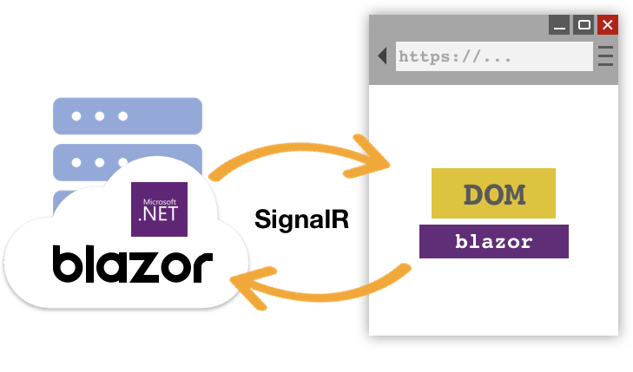
But, can it scale?
What’s the performance like?

Slide 34
Standard D1 v2 Instance (1vCPU & 3.5GB memory)
Over 5000 concurrent users
Standard D3 v2 Instance (4vCPU & 14GB memory)
Over 20,000 concurrent users

Slide 35
Small payload
No runtime to download
Fast load time
Everything is prerendered on the server
Access to the full runtime
Running on the server so can access the full .NET Core 3 runtime
Code security
Code stays on the server – never passed to the client

Slide 36
Heavy load on server
Server has to do all the work
Doesn’t work offline
Everything is on the server
Latency
Distance between client and server matters – a lot (<= 200ms).
Requires a fast and stable internet connection
Slow connections will result in a slow app

Slide 37
The future of Blazor…

Slide 38
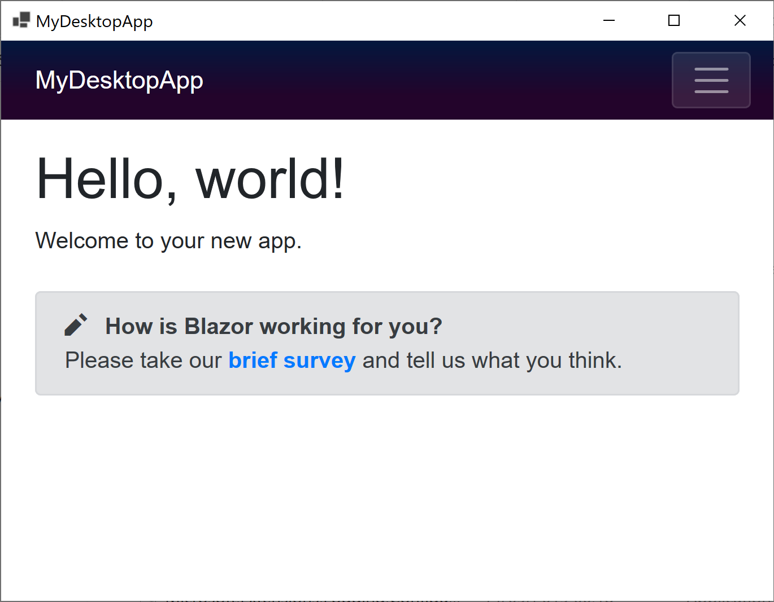
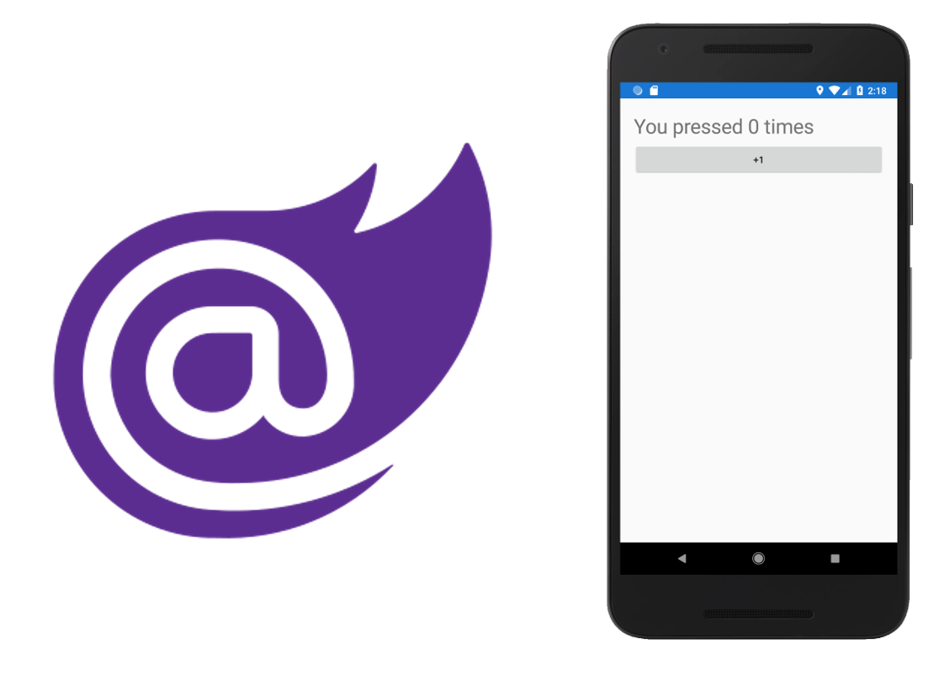
Other Hosting Models
Blazor Hybrid (.NET MAUI)
Mobile Blazor Bindings (Experimental)
Notes:
Blazor WebView

Slide 39
Other Hosting Models
Blazor Hybrid (via BlazorWebView)
Mobile Blazor Bindings (Experimental)

Slide 40
<div>
<p>Current count: @currentCount</p>
<button class="btn btn-primary" @onclick="IncrementCount">Click me</button>
</div>
@code {
private int currentCount = 0;
private void IncrementCount()
{
currentCount++;
}
}
ChrisSainty.com

Slide 41
Other Hosting Models
Blazor Hybrid (via BlazorWebView)
Mobile Blazor Bindings (Experimental)

Slide 42
<StackLayout>
<Label FontSize="30" Text="@($"Current count: { currentCount }")" />
<Button Text="Click me" OnClick="@IncrementCount" />
</StackLayout>
@code {
private int currentCount = 0;
private void IncrementCount()
{
currentCount++;
}
}
ChrisSainty.com

Slide 43










Your platform for building anything
DESKTOP
WEB
CLOUD
MOBILE
GAMING
IoT
AI
.NET

Slide 44

Blazor is a framework for building any UI
DESKTOP
WEB
MOBILE
ChrisSainty.com

Slide 45
Useful Resources
Blazor Official Site - https://blazor.net
Awesome Blazor - https://github.com/AdrienTorris/awesome-blazor
Blazor University - https://blazor-university.com
My blog - https://chrissainty.com

Slide 46
Next Steps
https://dotnet.microsoft.com/en-us/learn/aspnet/blazor-tutorial/intro

Slide 47

Blazor In Action (au35sai for 35% off)

Slide 48
Questions?
ChrisSainty.com

